Slide 1

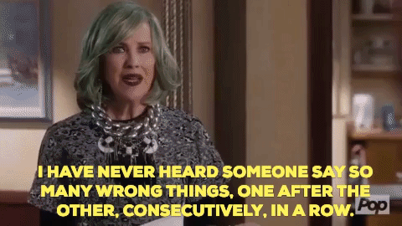

Tweet Sentiment Analysis
Schitt’s Tweet
(Group 2):
Corey McCulley
Christy Patrick
Igor Pavlunin

Slide 2
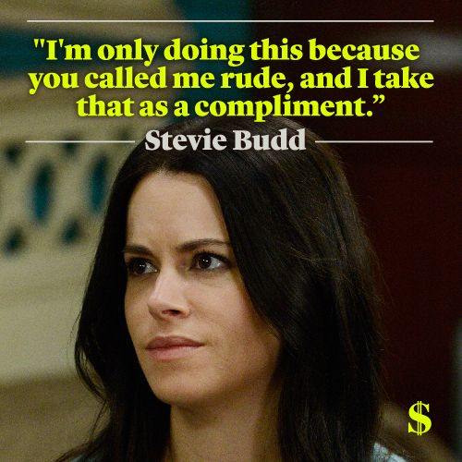


Project 3 Introduction
Utilize Machine Learning to:
Identify and score positive vs negative Twitter tweets
Categorize and score toxic tweets
Data Sources:
Toxic Comment Classification Challenge (Kaggle)
Twitter API

Slide 3


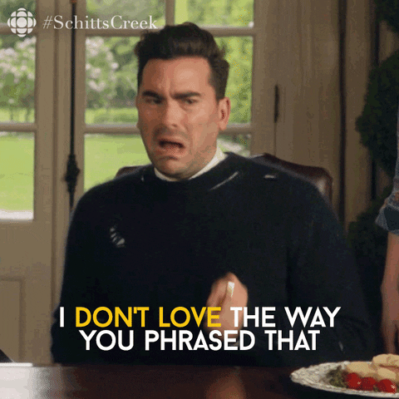
Positive-Negative Sentiment Analysis
Created a Natural Language Processing model that determines whether tweets are positive or negative and assigns a score ranging from 0 to 1
Major text processing libraries:
Sklearn.model_selection
gensim.models
Tensorflow.keras
Model accuracy: 98%???
Examples:
Positive Tweet (.988) – My vacation was amazing!
Negative Tweet (.025) – I can’t do this sh*t no more!

Slide 4

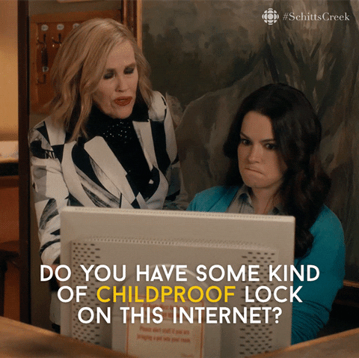

Toxic Tweet Classification
Created a NLP model that classifies tweets into 6 categories and assigns scores for each
Toxic
Severe Toxic
Obscene
Threat
Insult
Identity Hate
Major text processing libraries:
Sklearn
Keras
Model accuracy: 98%???
Examples:
Toxic Tweet (.998) – What the F**k is going on?

Slide 5
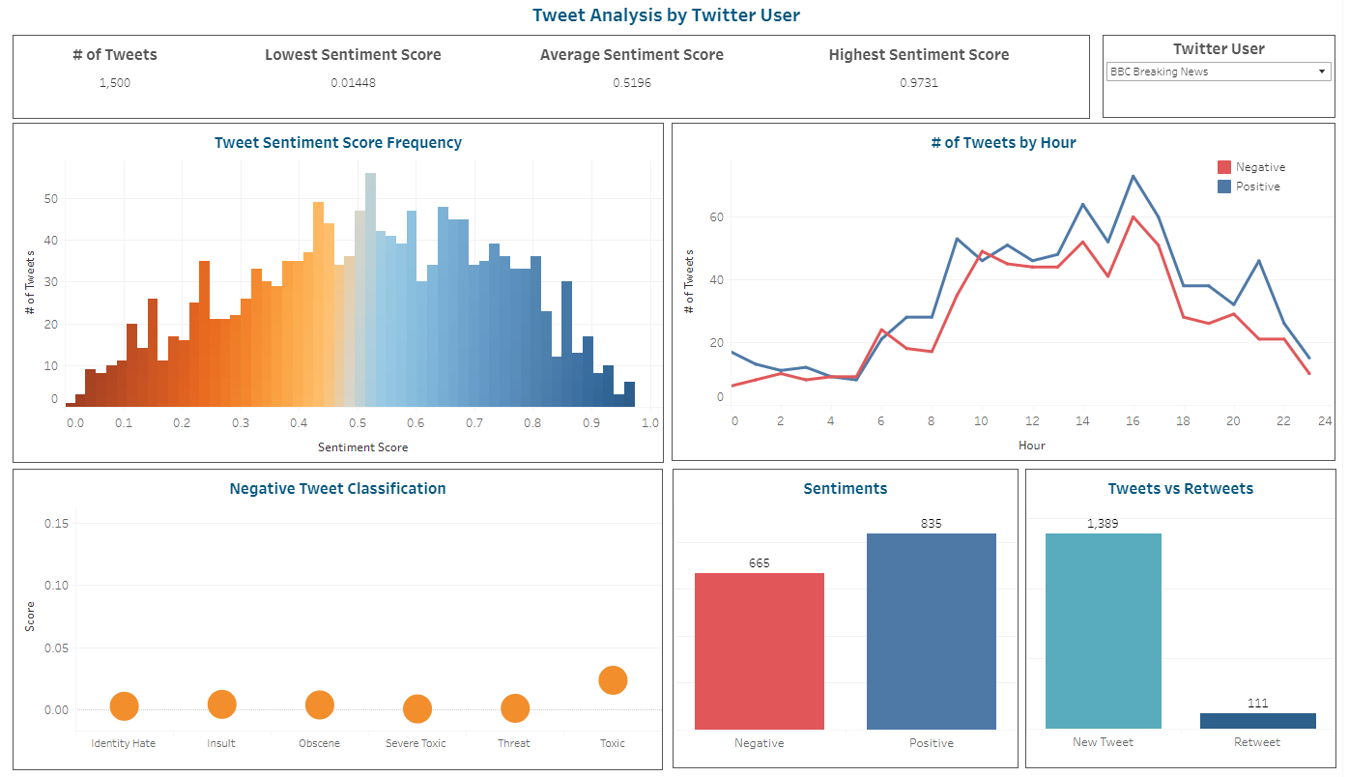
Tweet Sentiment Analysis Demo
This is just a placeholder – we can replace with a screenshot of the web page

Slide 6

Real-World Applications
Public relations
Influencers can gain assurance that their tweets are positive
Social media marketing
Gain insights on social media mentions

Slide 7



Questions?

